Slide 1


Robot Swarm Decision-Making:
Simulation of Kilots “Bees"
Presented by: Cecilia Aponte (1822225)
Paper: “Effects of Spatiality on Value-Sensitive Decisions Made by Robot Swarms.”
Authors: Reina A., Bose T., Trianni V., Marshall J.A.R.

Slide 2
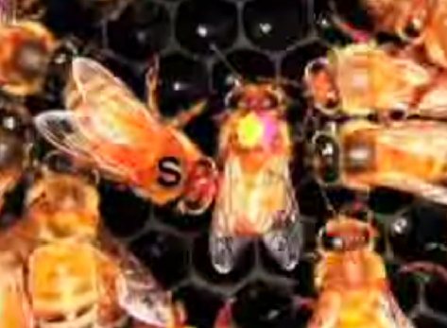
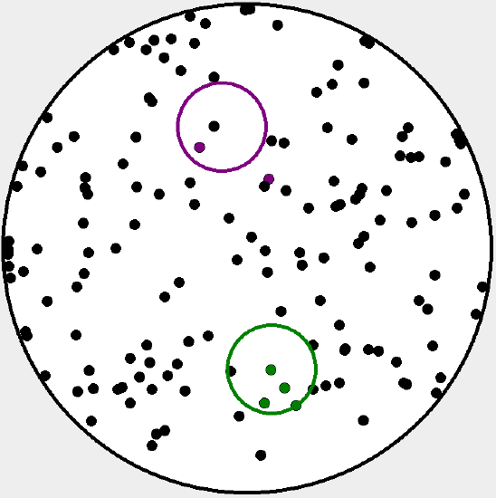
Background
Based on the collective decision-making process for honeybees to select a new hive
Two hives have the same quality. Both equally “great”, “good”, or “bad”
Bees (agents) explore area to reach a decision by reaching a quorum of agents committed to one target option.
Agents can commit/uncommit through the processes:
  Discovery: an uncommitted agent explores the environment to search for available options and upon discovery, gets committed with a probability
  Recruitment: an agent committed to one option recruits uncommitted robots with a probability
  Abandonment: an agent committedto one option spontaneously abandons its commitment and reverts to being uncommitted with a probability
  Cross-Inhibition: an agent committed to an option sends a stop signal to an agent committed to a different agent. The latter becomes inhibited and returns uncommitted with a probability
Swarm Decision-Making
Aponte, Cecilia (1822225)
17/03/20
Pagina <number>

Slide 3
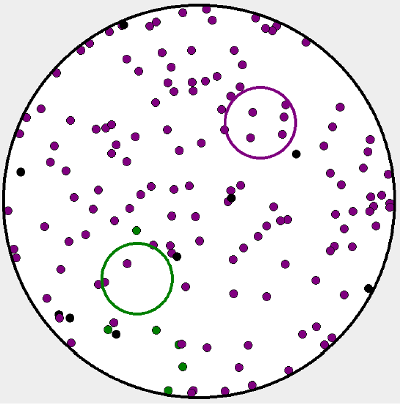

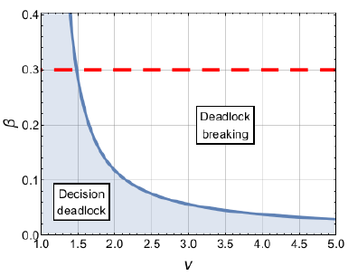
Concept of the System
All parameters given in the original system (environment area, #agents, target size/distance, etc) are identical.
  Used three quality values (1.5, 2, and 5)
Each experiment has 100 runs with random initializations and for 30 minutes even if it has/hasn’t reached quorum
Decision-making is explained in original paper using a macro- and micro-scopic model
  When there are enough agents committed to one option, deadlock is broken
Swarm Decision-Making
Aponte, Cecilia (1822225)
17/03/20
Pagina <number>

Slide 4
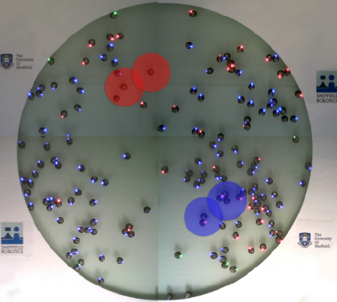
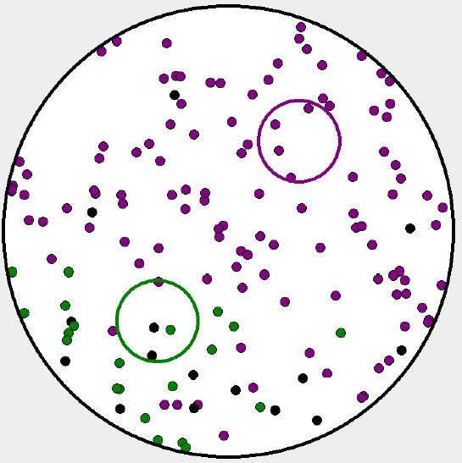
Overall Goal
Improve the similarity of the simulation with the kilobot experiments in the original paper [1]
  Compare the results by collecting data through similar methods and plotting it the same way
Analyze the effect of changes in:
  Distance between the target options
  Correlated Random Walk (CRW) exponent
  Levy Walk (LW) exponent
Swarm Decision-Making
Aponte, Cecilia (1822225)
17/03/20
Pagina <number>

Slide 5
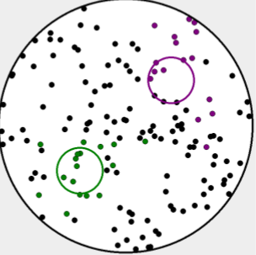
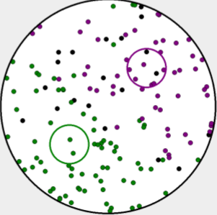
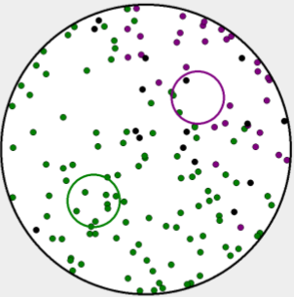
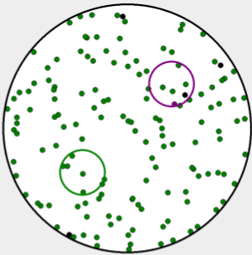
Simulation Example
quality = 5
Swarm Decision-Making
Aponte, Cecilia (1822225)
17/03/20
Pagina <number>

Slide 6
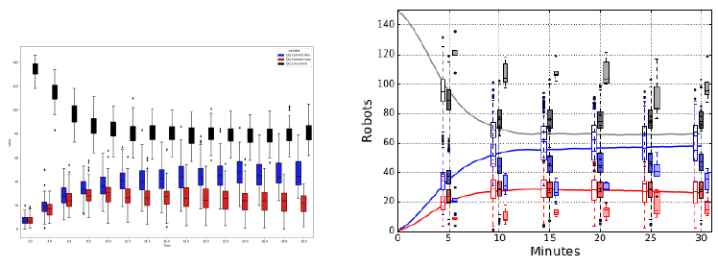
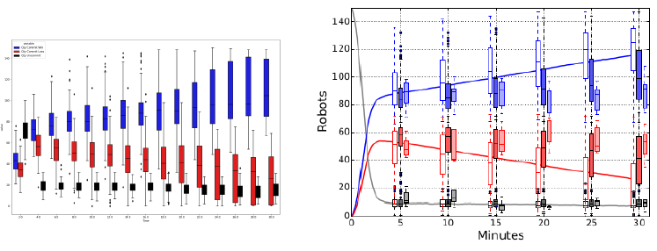
Results: Comparison with Paper (#Agents vs Time)
Current Simulation Original Paper
Quality = 1.5
Quality = 5
Conclusion:
Consistent with trends
Swarm Decision-Making
Aponte, Cecilia (1822225)
17/03/20
Pagina <number>

Slide 7
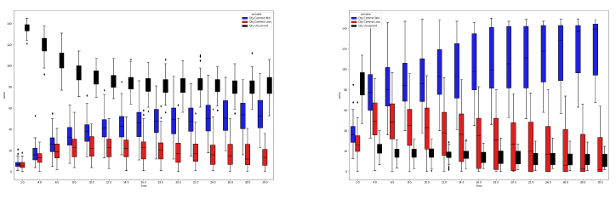
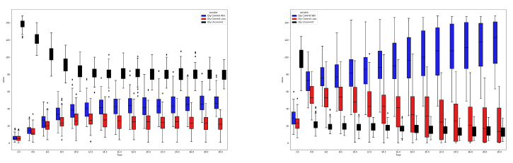
Results: Changing Distance between Target Options (#Agents vs Time) - part 1
quality = 1.5 quality = 5
Top: Distance = 0.28
Bottom: Distance = 1.22
Swarm Decision-Making
Aponte, Cecilia (1822225)
17/03/20
Pagina <number>

Slide 8
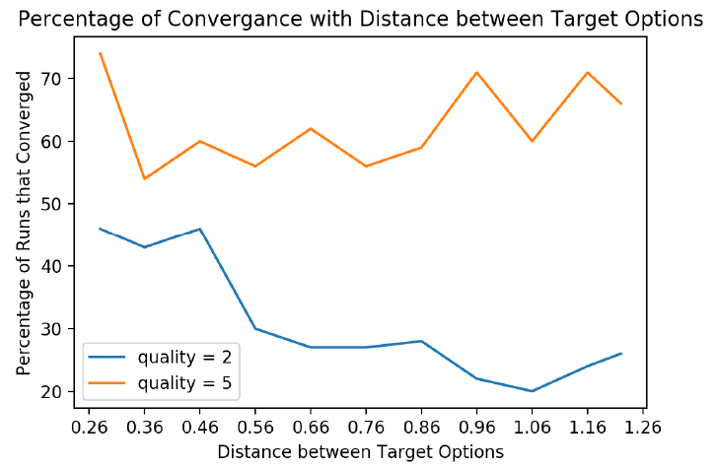
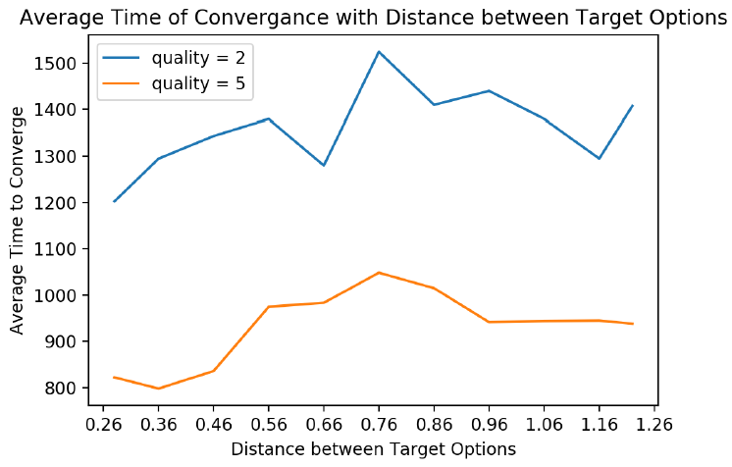
Results: Changing Distance between Target Options
(% / Time Converge vs Distance) - part 2
↓ distances, ↑ the % of convergence ↓ distances, ↓ avg time of convergence
Conclusion of best performance when quality = 5 and any of:
Distance = {0.28, 0.96, 1.16} Distance = {0.28, 0.36, 0.46}
Swarm Decision-Making
Aponte, Cecilia (1822225)
17/03/20
Pagina <number>

Slide 9
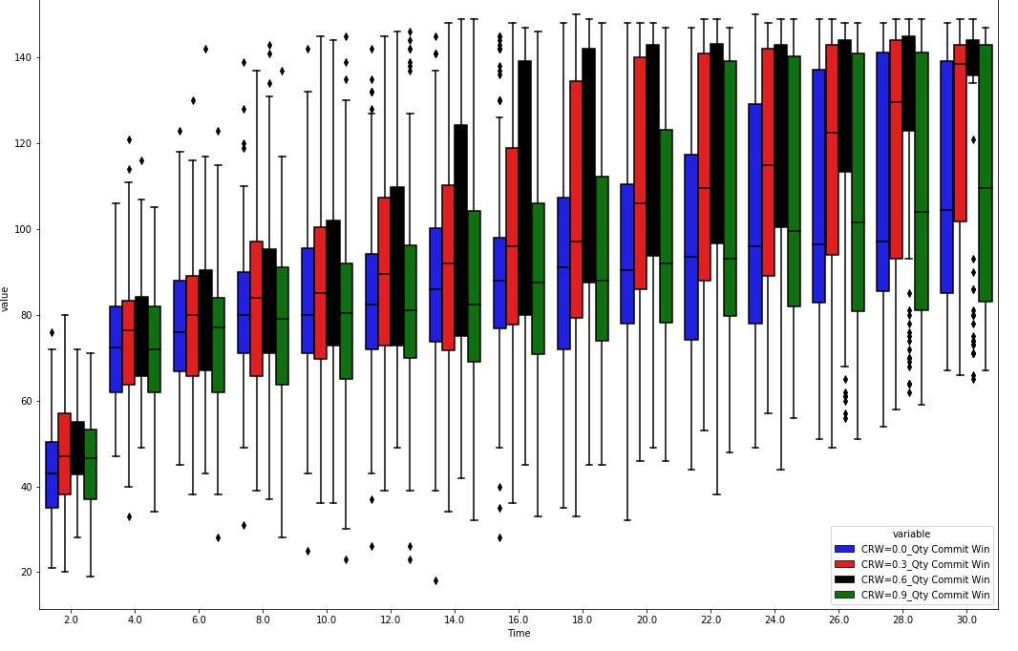
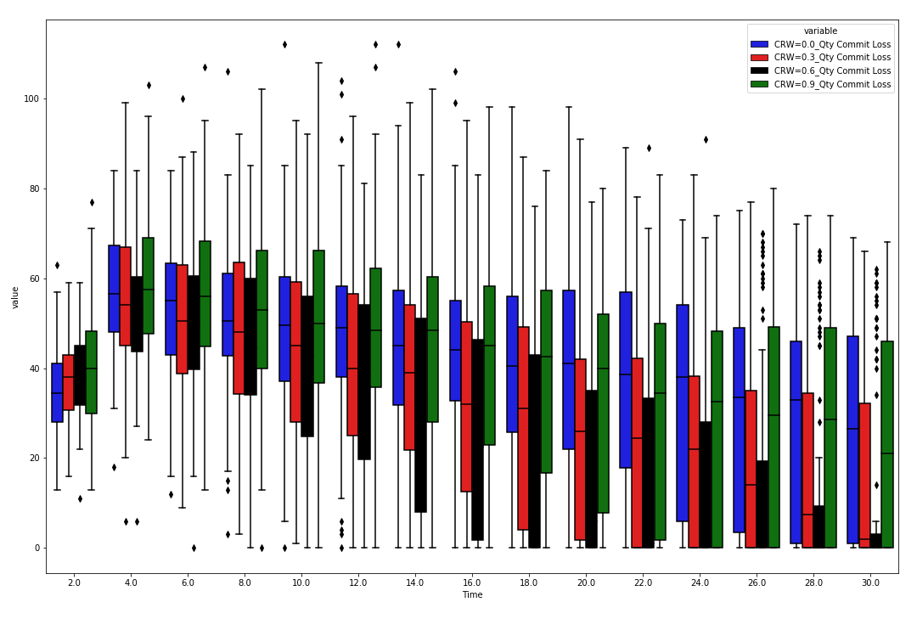
Results: Changing CRW and Levy Exponents (#Agents vs Time) - part 1
    Target Won Target Loss
Both: Levy = 2 & Distance = 0.76 & quality = 5
Conclusion: in general
↑ CRW: ↑ upper quartile (75\%) & ↓ lower quartile (25\%) at each time saved
CRW=0.9 shows no trend
Swarm Decision-Making
Aponte, Cecilia (1822225)
17/03/20
Pagina <number>

Slide 10
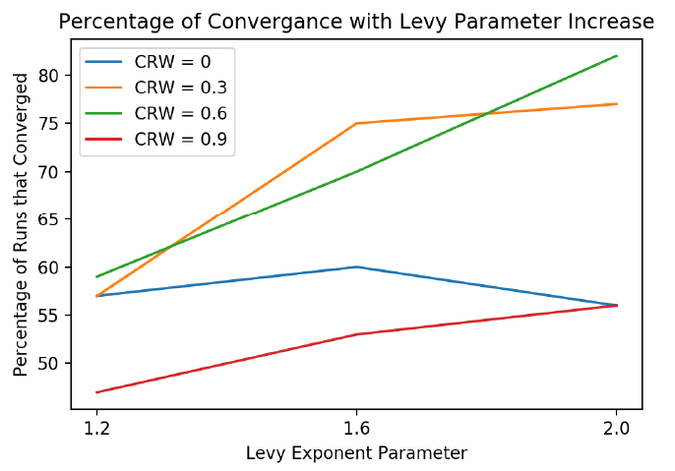
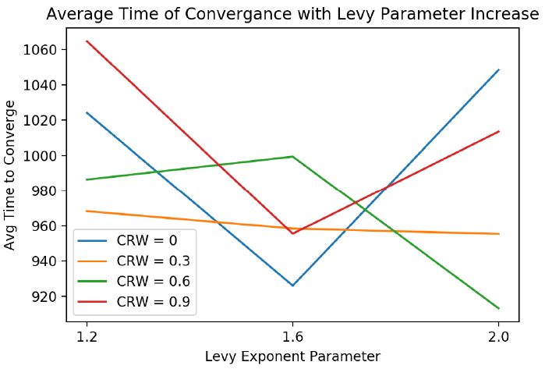
Results: Changing CRW and Levy Exponents
(% / Time Converge vs Distance) - part 2
↑ levy, mostly ↑ % of convergence No distinct trend
Conclusion of best performance at quality = 5 & distance = 0.76:
CRW = 0.6 & levy = 2 at ~88% CRW = 0.6 & levy = 2 at ~15 min
Swarm Decision-Making
Aponte, Cecilia (1822225)
17/03/20
Pagina <number>

Slide 11
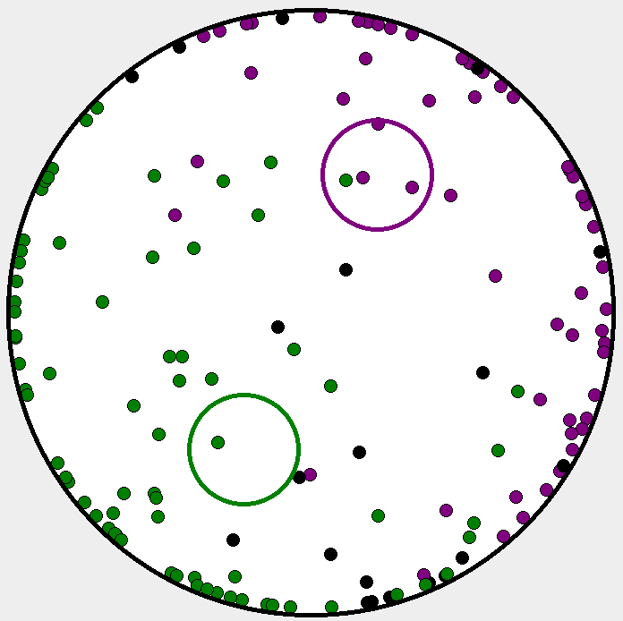
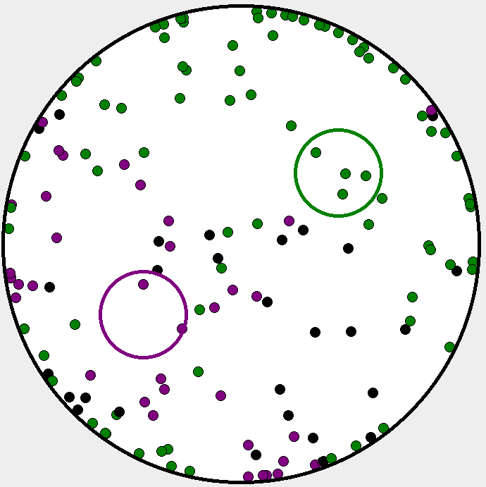
Results: Changing CRW and Levy Exponents
(% / Time Converge vs Distance) - part 3
    Levy = 1.2 Levy = 2
“Longer” jumps - stay at wall longer “Small” jumps – move out of wall faster
Both: CRW = 0.6
Swarm Decision-Making
Aponte, Cecilia (1822225)
17/03/20
Pagina <number>

Slide 12
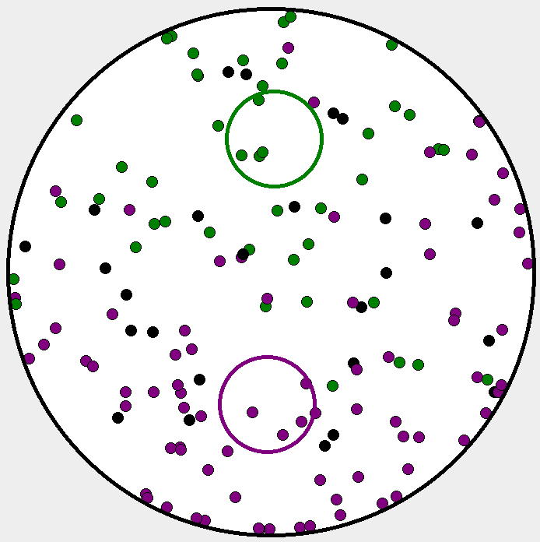
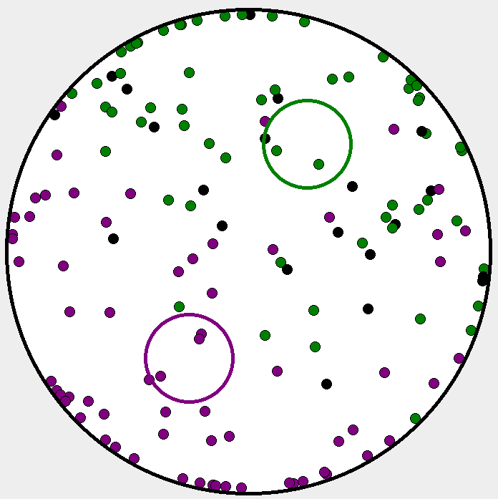
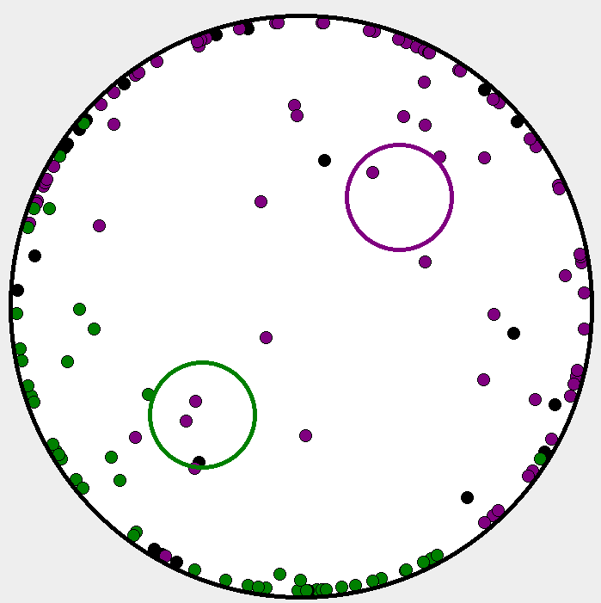
Results: Changing CRW and Levy Exponents
(% / Time Converge vs Distance) - part 4
  CRW = 0 CRW = 0.6 CRW = 0.9
Random angles Best – more mixing Angle same as previous
All: Levy = 2
Swarm Decision-Making
Aponte, Cecilia (1822225)
17/03/20
Pagina <number>

Slide 13


Conclusion
Best performance for both % Converged & Avg Time to converge are using quality = 5 and:
  distance = 0.28
  CRW = 0.6 and levy = 2
Worst performance using quality = 1.5, 2 or lower values and:
  distance = 1.06 for % converged
  distance = 0.76 for avg convergence time
  CRW = 0.9 and levy = 1.2
[2a]
[2b]
Swarm Decision-Making
Aponte, Cecilia (1822225)
17/03/20
Pagina <number>

Slide 14
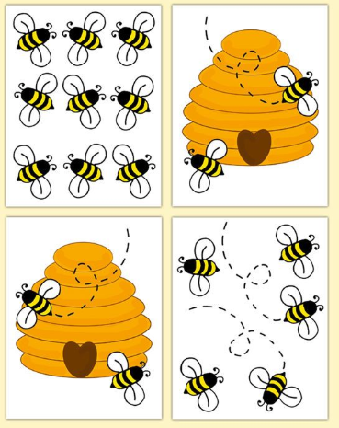
References
Reina A., Bose T., Trianni V., Marshall J.A.R. (2018) E
ects of Spatiality on Value-Sensitive Decisions Made by Robot Swarms. In: Grob R. et al. (eds) Distributed Autonomous Robotic Systems. Springer Proceedings in Advanced Robotics, vol 6. Springer, Cham
Images:
  https://depositphotos.com/138440562/stock-illustration-two-color-beehive-and-bee.html
  https://depositphotos.com/vector-images/angry-bee.html
  https://www.pinterest.com/pin/82331499446077652/
[2c]
Swarm Decision-Making
Aponte, Cecilia (1822225)
17/03/20
Pagina <number>

